Slide 1
Pune Municipal Corporation Budget 2015-16
In association with
Budget Analysis and Simplification by Janwani, Supported by MCCIA

Slide 2
Budget Making Process
Administrative ward
15 administrative wards prepare their budget
Departments
The HoDs of various departments prepare the department budget
Commissioner
The Commissioner prepares the budget on basis of the information received
Standing Committee
The SC modifies the Commissioner’s Budget
General Body
It is the final authority to approve the budget

Slide 3
Components of the budget
PMC Budget
Revenue Income
Income that is recurring in nature
All receipts are considered as revenue incomes by PMC.
Eg. Rents, grants, fees and charges
Capital Income
Income that is non recurring or one time
PMC does not account any income as capital income
Eg. Sale of land, lease of land
Revenue Expenditure
Expenditure that is recurring
Eg. Salaries, O&M
Capital Expenditure
Expenditure that is non recurring and massive in terms of amount.
Eg. Acquisition of land, purchase of real estate, construction of buildings.
Note: Capital Income classification not used by PMC – income coming from sale of land, and development charges is accounted as revenue income.

Slide 4
2015-16 PMC bUDGET
Revenue Side
Expenditure Side
Note that hence forth all the figures are rounded off to the nearest 100.

Slide 5
Trends in PMC BUDGET
40%
20%
15%
25%
Average annual increase of 6% in both Budget and Actuals
Actuals have been 70-75% of the Budget
Notes:
May be better as a bar chart?
Can we put Revised Estimates for 2014-15 in lieu of Actuals?

Slide 6
BREAK UP OF REVENUE INCOME
BUDGET ESTIMATES
ACTUALS
All figures in crores
Notes:
May be interesting to group the Income Receipts under “Own Sources” vs. “Grants & Loans”. That will give an insight into extent of PMC’s dependence on State funds.

Slide 7
1. OCTROI/ lbt
BUDGET ESTIMATES
ACTUALS
Octroi replaced with LBT in April 2013 – led to shortfall in 2013-2014
LBT to be abolished effective August 2015 – replacement not yet finalized
For 2014-15, revised estimates are same as budget estimates
Notes:
Can we have a short note on this slide explaining the difference between Octroi and LBT? Mentioning the fact that Maharastra Govt replaced Octroi with OBT in 2013.

Slide 8
2. Property tax
10% rate hike
BUDGET ESTIMATES
ACTUALS
6% rate hike
No “indexing” of property tax with inflation to maintain buoyancy
Collection Efficiency is just 35% - untapped potential for more revenue
For 2014-15, revised estimates are same as budget estimates
Notes:
Can we put Revised Estimate for 2014-15?

Slide 9
3. Building and Development charges
BUDGET ESTIMATES
ACTUALS
Actuals have remained relatively flat despite boom in real estate construction
Partly due to construction shifting outside formal PMC limits
For 2014-15, revised estimates are same as budget estimates
Notes:
Legend is not required, can be deleted.

Slide 10
Key Observations
Large variance between actual and budget on the revenue side which eventually leads to less spending than budgeted
Lack of diversification of revenue with 3 sources accounting a majority of the revenue
Dependency on grants is less compared to most other ULBs but this will change once LBT is abolished
Borrowing capacity not being tapped to fund capital projects especially where there is revenue potential from these capital assets

Slide 11
Break up of REVENUE EXPENDITURE
Budget estimates
actuals
Acutals at 90% of Budget
Notes:
Unless actuals and B.E. are put side-by-side it’s not possible to compare. We may remove Actuals if data does not fit.

Slide 12
1. salary
BUDGET ESTIMATES
ACTUALS
For 2014-15, revised estimates are same as budget estimates
Actual spend growing at 8% annualy
Rise of 50% in 2015-2016 due to inclusion of education department salaries and approval of 3,500 new posts
Notes:
Can put 2014-15 RE

Slide 13
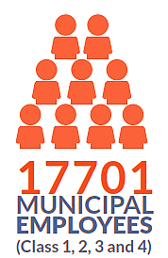
2014-15 Revised Budget
44 percent of estimate revenue expenditure spent on salaries
4.7 lakhs per head employee salary
2013-14 Actuals
47 percent of actual revenue expenditure spent on salaries
4.6 lakhs per head employee salary
2014-15
*Note that simple average method is used to calculate per head salary
Notes:
Can we put the 2015-16 figure for Salaries?

Slide 14
2. Operation and maintenance
BUDGET ESTIMATES
ACTUALS
For 2014-15, revised estimates are same as budget estimates
O&M expenditures include maintenance and repair works.
These have been consistently 8-10% of the total expenditures

Slide 15
Capital expEnditureS
BUDGET ESTIMATES
ACTUALS

Slide 16
Variance in CAPITAL EXPENDITURE
35%
35%
34%
65%
Note that PMC does not provide break down of actuals.
Major expenditures are on Roads, Water and Sewerage, and JNNURM projects
Consistently over estimated by 35% or more
Notes:
Can we put 2014-15 RE?
Can’t understand the last comment “Note that PMC does not give information on Actual expenditures in their Budget Book”

Slide 17
FUNCTIONAL ANALYSIS
Income and expenditure review as per functions of PMC
Analysis as per the functions of PMC. Not department wise analysis as each function can be performed by one or more departments

Slide 18
REVENUE INCOME by function
Share of tax collection is highest
Second highest is from planning and regulation
Third highest share is from water and sewerage service.
In Rs Cr

Slide 19
REVENUE EXPENDITURE by function
General administration is ~25-30%
Water and sewerage is ~20%
Public education is also ~20%
In Rs Cr

Slide 20
CAPITAL EXPENDITURES by function
Major share is for Public Works & Civic Amenities (~35%)
Second highest share is of Planning & Regulation (~27%)
Third highest share is of Water and Sewerage (~17%).
2015-16 Budget shows a rise of 86% for Sanitation and Solid Waste
In Rs Cr

Slide 21
Department analysis
WATER, Education, public health, slum improvement

Slide 22
DEPARTMENT WISE BREAKDOWN OF BUDGET
Sr. No | Department | Revenue Expenditure | Capital Expenditure | Total | % Of Total Budget
1 | Water | 354 | 369 | 723 | 16%
2 | Road Improvement Department | 85 | 585 | 670 | 15%
3 | Sanitation And Solid Waste Management | 262 | 117 | 380 | 8%
4 | Education | 340 | 34 | 374 | 8%
5 | Public Health | 162 | 36 | 198 | 4%
6 | Slum Improvement | 33 | 58 | 91 | 2%
In Rs Cr

Slide 23
Water department
In Budget 2015-16, a hike of 50% in water tax is proposed. Hence, the 66% rise in income.
Variance in Capital expenditures is huge.

Slide 24
Water DEPARTMENT
Water Supply by PMC = 1232 Million Litres/day
Total expenditure by water department (2015-16) = 500 crores per year
Population served = 2.7 million people (2011 census population is 3.1million → PMC water supply coverage is not 100%)
Cost of supplying water per person per litre per year = Rs. 5
Total water tax collected = Rs. 400 crores
Tax collected per person per day per litre day = Rs. 4
*Assuming entire population served is paying the tax

Slide 25
ROAD IMPROVEMENT
Income and revenue expenditure show a flat trend

Slide 26
SANITATION and solid waste management
Tax collected from citizens is the major source income
Major expenditure is towards salaries
Big gap between income and expenditure

Slide 27
SANITATION and solid waste management
Big projected increase in 2015-2016 due to decentralized waste processing, new landfill sites, more equipment, etc.

Slide 28
SANITATION and solid waste management
Budget 2015-16
Quantity of garbage collected = 1500 – 1600 tones
Revenue expenditure = 260 Cr
Capital Expenditure = 120 Cr
Total expenditure = 380 Cr
Cost of sanitation and solid waste management = Rs. 1 Cr/day
Revenue generation through sewerage tax = Rs. 8 Lacs/day
Revenue as % of Cost = 8%

Slide 29
EDUCATION DEPARTMENT
PRIMARY EDUCATION
REVENUE INCOME (Rs.cr) | 2010-11 Actuals | 2011-12 Actuals | 2012-13 Actuals | 2013-14 Actuals | 2014-15 BE | 2015-16 BE
Government Grants | 50 | 60 | 60 | 70 | 70 | 72
Income for Primary Education department is through government grants
Major Revenue Expenditures (2015-16) are in the form of:
Capital Expenditures (2015-16) are in the form of various development works (68%) in the schools followed by provisions for incomplete work (25%)
Salaries | Dearness Allowance | Pension
32% | 25% | 21%
Number of schools | Number of students | Students per school
275 | 84191 | 300
Total expenditure = 320 cr
Expenditure per school = 1.2 cr
Annual Exp per child =38,000

Slide 30
Slum improvement
CAPITAL EXPENDITURES (2015-16)
51% is allotted to development of works
39% for construction of toilets
91 crores are allocated for slum improvement in 2015-16 Budget, which is 2 % of the total budget
The latest Environment Status Report for 2012-13 says there are 564 slums in the city, of which,
353 (64%) are declared - their existence is officially recognized and they are provided basic services,
211 (36%) are undeclared and ineligible for basic services from the municipal corporation.
There are approximately 11.89 lakh people residing in slums, which constitutes about 40% of the city’s total population.

Slide 31
Urban transport fund (not a department)
Actuals are not available
Revenue Income comes from JNNURM grants, advertisement permission fee, hawker fee, deposits for road repairs, street tax.
Revenue Expenditure is for road repairs, street lights, PMPML allocations, PMPML salaries and pension, PMPML passes
Capital expenditures are for road repairs, public transport project, procurement of buses under JNNURM, vehicle management department, electricity department.

Slide 32
Observations on the budget document
45 revenue income heads
58 revenue expenditure heads
18 capital expenditure heads
No one-on-one connection between revenue heads and cost heads
No prioritization.
Inappropriate classification of line items
Actuals for capital expenditures are missing
Extra-ordinary receipts and payments lack clarity.
Some places object heads and accounting heads are used in combination.
Summary sheets and detailed sheet totals do not match.
Notes:
Others have major allocation

Slide 33
Comparative analysis of pmc with other indian cities

Slide 34
Budget Per Capita & Quality of Budget Estimates
City | Bangalore | Chennai | Jaipur | Surat | Hyderabad | Mumbai | Pune
2011 Pop (Lacs) | 84.4 | 46.5 | 30.5 | 44.7 | 67.3 | 124.4 | 31.2
ULB Area | 741 | 426 | 467 | 327 | 923 | 437 | 244
Per capita allocation | 7,974 | 9,615 | 3,980 | 10,202 | 8,247 | 28,414 | 14,356
7%
7%
11%
17%
12%
11%
1%
56%
Data from municipal budgets
Notes:
Can you add a row in the table that shows the per capita budget allocation?

Slide 35
Proportion of Capital Expenditure
Rs 2,240 Cr
Rs
985
Cr
Rs
1,254
Cr
Figures in %
Estimates for the year 2015-16
Data from municipal budgets
Notes:
Please mention the year for which this data is applicable.

Slide 36
Capex Budget vs Capex Requirement
Pune with a projected 2030 Population of 10 million will be the 5th most populous city in India
It will contribute USD 76 billion (Rs. 4,56,000 Cr) in terms of City GDP placing it higher than all Indian cities except Delhi, Mumbai, Kolkata and Bangalore.
Creation of the necessary infrastructure and services to support this growth will require closing the gaps in several areas.
Water supply duration is inconsistent, partial household meter coverage.
Only 50% sewage is treated and only 6% is recycled
Household level solid waste coverage of only 53% and only 28% of waste is segregated
Share of public transport at 22% as compared to a best in class average of 50-80%
Road drainage network only 52% of required capacity
33% of people in PMC live in slums
Budget 2015-16 Per Capita Capex (Rs.)
7,178
7,178
Budget 2015-16 Per Capita Opex (Rs.)
24%
Required Per Capita Annual Capex (Rs.)
9,418
Required Per Capita Annual Opex (Rs.)
6,960
12.6%
1.3%
2.7%
16.8%
33.2%
33.4%
Based on the 2010 McKinsey Global Institute Report ”India’s urban awakening: Building inclusive cities, sustaining economic growth”. Population and GDP are projected figures for year 2030.
Water & Sewage | Solid Waste | Road Drainage | Roads | Public Transport | Slums
Notes:
Please mention the year for which this data is applicable.

Slide 37
Own Revenues
Figures in Rs Cr
Estimates for the year 2015-16
Data from 2015-16 municipal budgets
Notes:
Please mention the yean ar for which this data is applicable.

Slide 38
What should we ask for?
Budgets are presented on time, are reasonably detailed and not hugely overestimated
What Works
Capital expenditure as a % of total expenditure is healthy; so are Own Revenues compared to both Total revenues and Capital expenditure
Participatory Budgeting a huge plus
Fiscal Responsibility
Medium Term Fiscal Plan
Fiscal Decentralisation
Own Revenues
Audited Financial Statements
Land-based financing
Profession tax
Entertainment tax
Accountability
for Performance
for Expenditure
What else should we ask for?
Notes:
Can we shorten the process descriptions? e.g. Administrative Ward Level: Budget inputs sent in by Ward Officers are compiled by Head Office

Slide 39
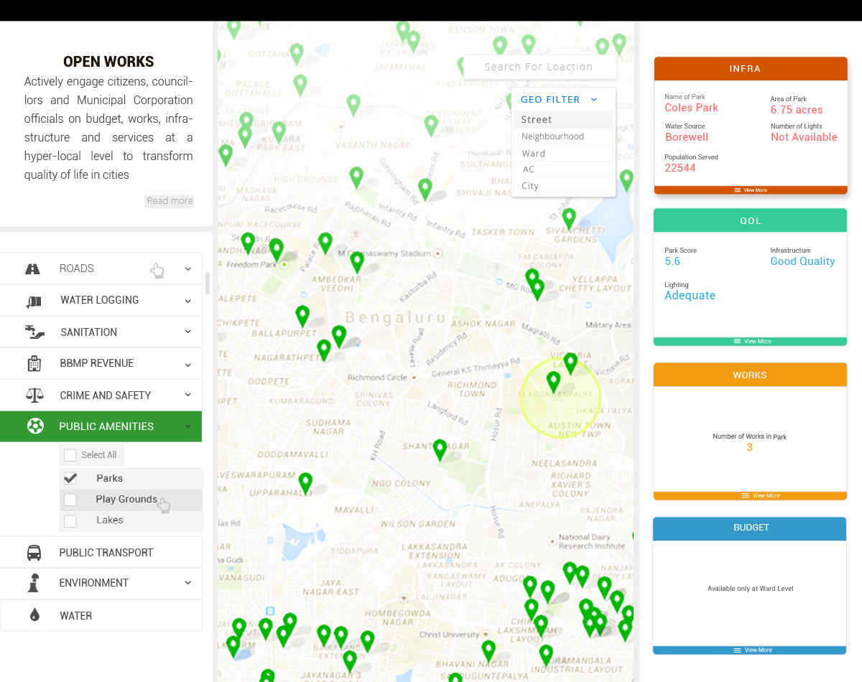
A Model of Accountability for Expenditure
Ward Quality Score
Works
Budgets
Infra & Services
Notes:
Can we shorten the process descriptions? e.g. Administrative Ward Level: Budget inputs sent in by Ward Officers are compiled by Head Office

Slide 40
Urban Capacities and Resources
ASICS UCR - Financial Management Parameters | Pune’s Performance
Is the ULB empowered to set and collect the following taxes? << pertains to Fiscal Autonomy
Property tax | Y
Entertainment tax | N
Profession tax | N
Advertisement tax | N
What is the Percentage of Own Revenues to Total Expenditure for the ULB? | 96.36
Is the ULB authorised to raise borrowings without State Government/ Central Government approval? << pertains to Fiscal Autonomy | N
Is the ULB authorised to make investments or otherwise apply surplus funds without specific State Government/ Central Government approval? << pertains to Fiscal Autonomy | Y
What is the Per Capita Capital Expenditure of the ULB? Taking Mumbai as 10. | 4,010
Is the budget of the ULB realistic? Is difference between Budget and Actual <15%? | N
Is the ULB required by law to have a Long-Term and/or Medium-Term Fiscal Plan ? | N
14th FC recommends States to help ULBs enhance the scope of these 4 revenue sources
Notes:
State total grant is fixed but cities within States will compete for Performance Grants

Slide 41
Transparency, Accountability and Participation
ASICS TAP – Financial Parameters | Pune’s Performance
Is the State PDL compliant with the Model PDL with respect to:
Audited financial statement on quarterly/annual basis? | Y
Details of plans, income and budget | Y
Has the ULB adopted open data standards and principles in respect of:
Financial information (budgets) of the corporation and of respective wards. | N
Quarterly audited financial reports | N
Is the ULB required by its Municipal Act to carry out an Internal Audit within a predetermined frequency, at least annual? | Y
Are the annual accounts of the ULB mandated to be audited by an independent/external agency? | N
Are the internal audits and audited annual financial statements of the ULB available in the public domain? | N
Does the governing legislation of the ULB require the auditor to submit its report to the Council and/or the State Legislature? | Y
Does the ULB have a participatory budgeting process in place? | Y
Notes:
State total grant is fixed but cities within States will compete for Performance Grants

Slide 42
Discussion and Q&A

Slide 43
ANNEXURES

Slide 44
SALARY TRENDS- Functional wise
Salary expenses are most for Sanitation and Solid Waste Management, which includes, road cleaning, sewage and waste transportation.
The second highest expenditure is on general administration

Slide 45
SECONDARY EDUCATION
REVENUE INCOME (Rs.cr) | 2010-11 Actuals | 2011-12 Actuals | 2012-13 Actuals | 2013-14 Actuals | 2014-15 RE | 2015-16 BE
Fees and Charges | 0.0 | 0.0 | 0.0 | 0.0 | 0.0 | 25.0
Grants | 13.8 | 12.6 | 21.8 | 15.8 | 25.0 | 25.0
Income for Secondary Education department is through government grants
The major revenue expenditures (2015-16) are on:
The capital expenditure (2015-16) is for construction of toilets- Amount is 3 lakhs. (only one head)
Salaries | PMPML bus service
50% | 27%
Total expenditure on Secondary Education = Rs. 54 cr
Number of Secondary Schools = 16
Expenditure per school = Rs. 3.4 cr

Slide 46
PUBLIC HEALTH
Revenue Income
Actuals Actuals Actuals Actuals Revised Budgeted
Major income is from funds received for health assistance to employees and members
Fees and charges seem to be a consistent source of revenue (no fluctuations)
Other grants show a decreasing trend.

Slide 47
Slum improvement
Revenue Income
2015-16 Budget has estimated 78% of income from service charges. (480 % rise)
Post 2011-12, there has been no expense on housing scheme for the SC/STs.
SRA Grants constitute ~20% of total

Slide 48
Social development funds
Women and child development fund, backward class funds

Slide 49
Women and child development fund- L budget
Falling trend in L Budget allocations.
~80-90% is in the form of revenue expenditures.
Year on year growth is (-) 1%
Note: Actuals are not available
Major expenditures are towards education of children followed by slum improvement till 2014-15. In 2015-16,major expenditure is towards PMPML (55%)
5 percent of expenditures, after deduction of committed
expenditures, should be towards women and child development fund

Slide 50
Backward class fund – ‘b’ budget
Rising trend in allocations to B Budget.
5 percent of the entire budget shall be allocated for the backward class citizen’s from 1992-93.
Year-on-year growth is 23%.
Note: Actuals are not available
Dalit population (Census 2011) - 4,53,421 (14 % of total population)
Non Dalit Population (Census 2011) - 26,71,037
Per capita allocation = Rs 5212 per person

Slide 51
URBAN POOR Budget – P Budget
~40 percent of the total budget is considered at urban poor budget.
Example, Slum improvement department’s entire budget is included in P Budget.
Road department’s 40% budget is included in P budget.
Note: Actuals are not available
A representative budget: As the Pune City has 40% of the total population staying in slums, the PMC departments that have works that seemingly benefit the poor have been considered to spent 100 percent of their budget as urban poor budget.

Slide 52
PUBLIC HEALTH
Revenue Expenditure (2015-16)
Capital Expenditure (2015-16)
Salaries | Material purchase | Grants/ assistance to weaker sections
56.4% | 23% | 10%
Development works in hospitals | Provisions for incomplete works of previous years | Development of crematoriums
48% | 26% | 25%
Budget 2015-16
Total Revenue Expenditure = Rs. 160 cr
Total Capital Expenditure = Rs. 40 cr
Total Expenditure = Rs. 200 cr
Total Number of Hospitals and Clinics = 87
Expenditure per clinic/hospital= Rs. 2.3 cr

Slide 53
SLUM Improvement
Revenue Expenditures
~60% is spent of salaries
~30% on ward office works
~10-15% on toilet repairs
Percentages relate to actuals

