Slide 1
UnLtd Tamil Nadu

Slide 2
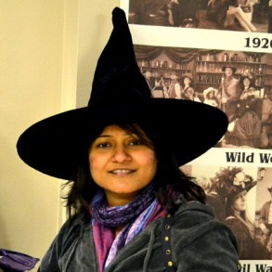
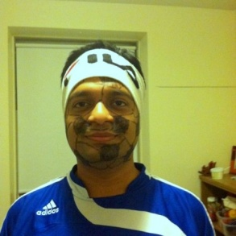
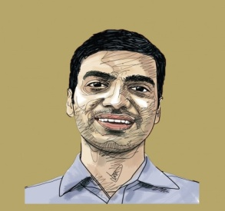
Khel Planet
Life skills through play.
Co-Founders : Neelam, Saurabh & Santhosh
Current Investee : Level 1,2014
Area: Based in Chennai, Lucknow and Delhi
khelplanet.org
The issue: A Large number of children in India never play because they have to work and support their families or because they have no toys to play with or because their schools do not have playing spaces or because their parents and teachers think that playing is a waste of time. Khel Planet teaches life skills through play. The idea: Every child has skills to create a happy life for self and community. Khel planet designs games that are set in the local context, conduct workshops designed to provide experiential learning, set up toy libraries to give an immersive experience and work towards promoting this as a movement to promote play in India.
How it started: Realizing that they had been fortunate enough to have educated parents, tutored by motivated teachers and had grown up into well-to-do careers three friends Neelam, Santhosh and Saurabh jointly started Khel Planet.
The team: Neelam, Santhosh and Saurabh are co-founders of Khel Planet. Neelam is the boss who studied both in IIT and Harvard and has work-experience both in the corporate and not-for-profit sector. Santhosh , the chief creative junkie is an IIT graduate addicted to Entrepreneurship and launched several ventures online including an online toy library for kids. Saurabh is the chief statergy samurai who was a public sector consultant in his previous avatar and studied public administration at Harvard University. Khel Planet and UnLtd Tamil Nadu: Neelam, Saurabh and Santhosh asked UnLtd Tamil Nadu to support them with coaching, networking, governance and access to experts. They are also being provided with seed funding of Rs 80000 ($ 1365).
*UN data
UnLtd Tamil Nadu

Slide 3
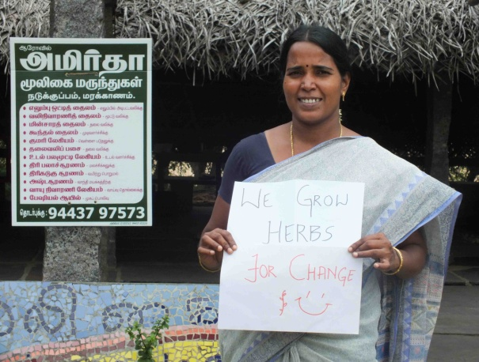
Amirtha Herbals
The issue: There is a decline of traditional medicinal practices. Amirtha Herbal works to provide affordable healthcare through the constructive use of local knowledge in rural areas. The issue of unemployment and migration is addressed through income generating activities for the ultra poor communities in the bioregion The idea: Parvathy’s dream is to build a social enterprise model aimed at; Providing quality, affordable herbal medicinal products by rehabilitating local traditions into health care practices in rural and urban areas of India. This is done by contributing to the financial and social development of women and BPL communities in the bioregion by creating income generating opportunities and conducting capacity building programs for beneficiaries.
How it started: Parvathy’s father is a healer and during her childhood she would collect plants for his medicinal practice. This interest led her to explore Pitchandikullam forest for 14 years and discover the healing that medicinal plants can offer. The team: The social enterprise is co-owned by women groups who take care of collection, processing and marketing. They share a common understanding of grassroots development of herbal medicine. The women groups co-create the herbal unit and are focused towards building a sustainable social enterprise model that is committed to impact local bio-region.
Amirtha Herbals and UnLtd India: Parvathy asked UnLtd Tamil Nadu to support her with access to talent for business planning strategy and distribution networks (bulk order companies, NGOs, e-commerce platforms eventually) , coaching on hard business skills , tie up with a consultant designer , drug license assistance and framing of the management structure .
We grow herb for change
Parvathy
Current Investee : Level 1, 2013; Level 2 ,2014
Area: Villupuram
unltdtamilnadu.org/investees/amirtha-herbal/
UnLtd Tamil Nadu

Slide 4
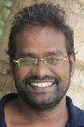
Yurt on Wheels
Creating opportunity to access education for gypsy children
John Peter
Current Investee : Level 1, 2014
Area: Pondicherry
The issue: Kids from lesser privileged nomadic backgrounds in India have limited access to mainstream education.
The idea: John’s project “Yurt on Wheels” works for the up liftment of children belonging to the nomadic and marginalized communities in Pondicherry through education. He will use a rickshaw to reach out to his beneficiaries to provide education, livelihood training and advocacy for the Narikuravar tribe in Pondicherry.
How it started: John Peter’s work in the developmental sector post Tsunami created a urge to work for the less-fortunate children in his locality. This made him work for a Gypsy community that is struggling with social stigma and challenges relating to poverty, unemployment, early child marriage, disease, and lack of knowledge about government facilities and other sources of support.
The team: John is a social worker and has been working in the developmental sector for the past 6 years. Yurt on Wheels is his initiative for which he managed to register the organization, run regular classes and conducted a summer camp.
Yurt on Wheels and UnLtd India: John Peter asked UnLtd India to support him with livelihood project, mentoring, identify local resources and coaching.
UnLtd Tamil Nadu

Slide 5
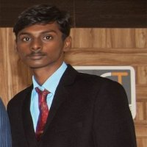
Teekz
Creating studentrepreneur
Tendul Raj
Current investee: Level 1, 2014
Area : Pondicherry
www.teekz.in
The issue: Students in rural India have limited access to technical skills that get them employed. Teekz works to bridge the rural urban divide through creating studentrepreneur by use of technology.
The idea: : Teekz aims to provide practical training for rural students in technology and Entrepreneurship. This is done by conducting training programmes on game, Web and Apps development and also providing the participants with hands on training and live projects.
How it started: After graduation Tendul Raj , started Teekz as a platform for students with enthusiasm and talent . These students belong to rural areas and so have less access to technology and quality services. Teekz provides quality practical education .
The team: Tendul Raj is the founder of Teekz and works with a team of dedicated workforce who were once his own students trained at Teekz.
Teekz and UnLtd India: Teekz asked UnLtd Tamil Nadu to support him with networking, peer-learning, coaching, workshops, mentoring and financial support.
UnLtd Tamil Nadu

Slide 6
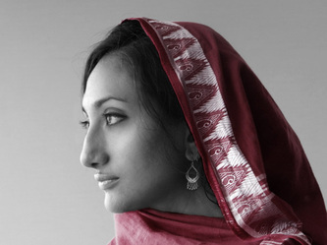
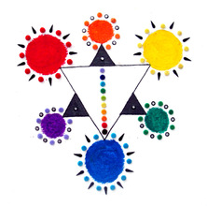
Sankalpa
The issue: Low self esteem and Lack of confidence in social interactions is addressed through art.
The idea: Sankalpa seeks to heal trauma, improve self esteem, cultivate emotional expression and empower individuals through creativity and art engagement. Supportive spaces, resources and education are provided and a platform is created to facilitate global art exchange.
How it started: Art has been a personal path to gain resilience through Kirupa’s life challenges. After formal graduate training, she decided to share the deeper potential from the field of art therapy . She wanted to cultivate emotional awareness, insight and storytelling to heal trauma and empower children through original self-expression and hence Sankalpa.
The team: Sankalpa is the dream of Krupa Jhaveri. She is an international art therapist and art director. Born in the US, she has an Indian ethnic origin. she has experience working with children and women with HIV/AIDS, in child protection, Trauma-Informed Art Therapy, and the combined practice of Art & Yoga.
Sankalpa and UnLtd Tamil Nadu : Sankalpa would like to receive support from UnLtd Tamil Nadu to understand relevance from outside art therapy and in developing a sustainable revenue model. UnLtd also enabled Sankalpa to receive feedback on communication of project and was supportive in the crowd funding process.
Sankalpa provides art therapy and creative empowerment programs, to facilitate insight and connection through art.
Krupa
Current Investee : Level1,2014
Area: Auroville
www.sankalpajourneys.com
UnLtd Tamil Nadu

Slide 7
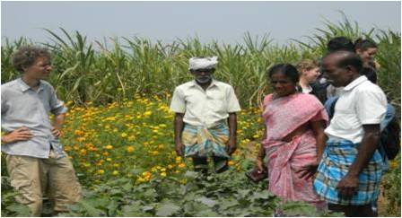
Care Society
Say no to chemical fertilizers and yes to seed bank for traditional seed varieties.
Sivalingam and Kumari
Current Investee : Level 1, 2013
Area: Villupuram
unltdtamilnadu.org/investees/care-society/
The issue: Decrease in number of traditional seed varieties and non-availability of eco-friendly seeds for multiplication is an issue that is addressed through creation of seed banks for traditional seed varieties and organic farming by saying no to monoculture of crops.
The idea:Empowerment of socially and economically backward communities through education, economic development, organic farming , environmental protection and creation of seed banks.
How it started: Sivalingam and Kumari were highly concerned about chemicals and fertilizers used in crop cultivation. After much research they decided to start a seed bank and promote organic farming which led them to start Care Society.
The team: Kumari is trained as a farmer field school facilitator in Trichy. Sivalingam is promoting replication of her model in Marakannam.
Avanti Fellows and UnLtd Tamil Nadu: Care society asked UnLtd Tamil Nadu to help them in networking with peers and partners, human resources support to carry out administrative work and training on ICT techniques.
UnLtd Tamil Nadu

Slide 8
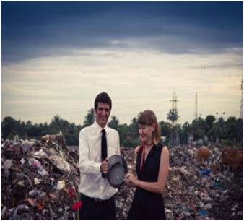
WasteLess
The issue: WasteLess is dedicated to changing harmful habits surrounding how we make, dispose of and think about waste. We target the future generation to bring about behavioural change by spreading awareness on waste and its relationship to consumerism and the effects on the environment.
The idea:Ribhu and Chandrah want to create a world where the concept of waste does not exist and shall do this by; Making learning about waste, consumerism and the environment fun and targeting the future generation to bring about behavioral change, Enabling organizations to effectively manage waste today and increase resource recovery and Spread awareness, advocate responsible waste management practices and reduce recovery.
How it started: After working in a huge corporation for 3 years Ribhu felt that microfinance would be a great tool to bring about positive change to the rural south Indian community where he grew up. He left his corporate job for a yearlong trip with his wife Natasha. On returning home he realized that microfinance loans were similar to consumption loans putting him back in a similar situation as his corporate job. He then joined a campaign which focused on innovative waste awareness which started in August 2009
The team:Chandrah-has valuable experience in running rural solid waste management projects and an MA in pedagogical sciences. She is passionate about the science of education and waste.
Ribhu has a diploma in innovative communication and training management skills along with experience working for global mobility projects for Shell International. He is passionate about waste and cares deeply about issues with waste in India.
WasteLess and UnLtd Tamil Nadu: WasteLess asked Unltd Tamil Nadu to support them with coaching, mentoring, peer learning and training on various start-up topics and access to experts and networks. Rs 2 Lakhs ($3,400) of seed financing and advice on developing a financial model, fundraising strategy is also provided by UnLtd Tamil Nadu.
It’s time to WasteLess
Current Investee : Level 2, 2014; Level 1, 2013
Area: Auroville www.iwasteless.org
UnLtd Tamil Nadu

Slide 9
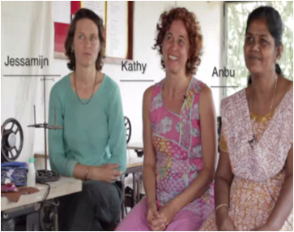
Ecofemme
The issue: Little environmental friendly sanitary alternative, little access to information about menstruation
The idea: Eco Femme is a global women’s empowerment initiative. Rising from rural India, reaching out to women around the world, they promote and revitalize menstrual practices that are healthy, dignified, affordable and eco positive.
How it started: Pad is a practical product that every woman needs, whatever background she has. Interested in social enterprise development, women's empowerment and in environmental issues associated with each of them, Kathy and Jessamijn find menstruation increasingly interesting, because this helps to get connected to one’s identity and gives a sense of self-worth/dignity. The environmental and social impact of waste -including sanitary waste- in India are tremendous. Hence, Eco femme.
The team:The Co-founders of Eco Femme, Kathy Walking and Jessamijin Miedema, are committed social entrepreneurs with track records in fair trade, organic farming and rural outreach. They have partnered with several organisations to increase Eco Femme’s reach and effectiveness.
Ecofemme and UnLtd Tamil Nadu: Eco Femme asked UnLtd Tamil Nadu to support them with coaching to improve the founders’ skills and confidence, support on business development, strategic planning and pricing, access to peers, experts and service providers and 2 lakh seed financing
Washable Cloth Pads
Kathy and Jessamin
Current Investee: Level 2, 2014 ;Level 1,2013
Area: Auroville ecofemme.org
UnLtd Tamil Nadu

Slide 10
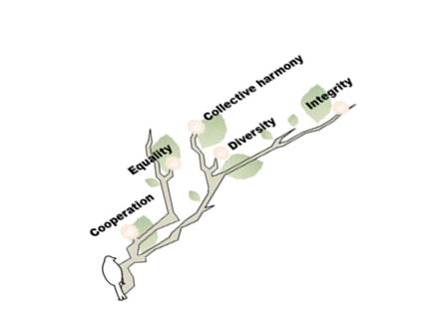
Koodam
Conflict resolution and amicable solution.
Elivra
Current Investee: Level 1, 2014
Area: Auroville
unltdtamilnadu.org/investees/koodam/
The issue: Conflicts are a fact of life. They happen when interdependent people have feelings, goals or values that are (or seem) incompatible. Conflicts hold a great potential for positive change - if dealt with constructively.
The idea: Elvira’s dream is to create an environment that helps the community to cultivate a responsible consistent and collaborative approach to engaging with one another.
How it started: : Elvira’s profession involves conflict transformation in which she plays an active role in mediating, consulting and facilitating from different realities-from rural Palestine to middle class India to the boardrooms of Daimler. Koodam springs from the convergence of two things close to her heart: her profession and her home.
The team: Elvira and Niva are two full time coordinators trained and experienced in mediation.
Koodam and UnLtd Tamil Nadu: Elvira asked UnLtd Tamil Nadu to support her with coaching, help design business model, networking and social impact measurement.
UnLtd Tamil Nadu

Slide 11
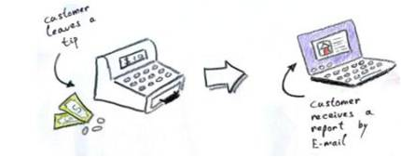
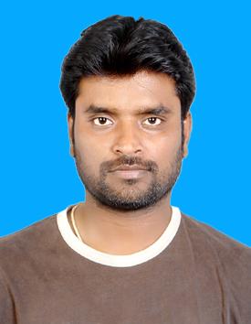
Tip4change
Power of crowd for social change.
Anil
Current Investee : Level 2, 2014, Level 1, 2013
Area: Auroville
unltdtamilnadu.org/investees/tip-4-change
The issue: : Driving sustainability in the market by improved transparency and mobilizing the power of crowd for social change.
The idea:Tip4change uses Smartphone technology to connect small producers in rural India with global consumers. Transparency is used as a self-regulatory mechanism to eliminate social and environmental exploitation. Sustainable community development is integral part of the model.
How it started: : Anil’s extensive work with small and marginal farmers of Andhra Pradesh provided him with all the knowledge and skills required to execute his project.
The team: After graduation anil has had 10 years of experience in the field of project design and implementation, team leading, marketing and capacity building.
Tip4change and UnLtd Tamil Nadu: Anil asked UnLtd Tamil Nadu to support him with seed financing of Rs 1 lakh, coaching to develop the founders skills, networking and partnership financial model development, peer learning, access to interns and volunteers.
UnLtd Tamil Nadu

Slide 12
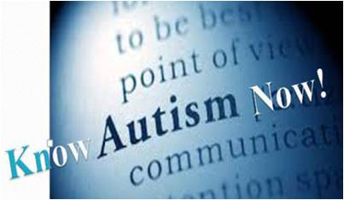
Know Autism Now
Fight social stigma around autism and provide care.
Nachiappan
Current Investee: Level 1, 2014; 2013
Area: Coimbatore
unltdtamilnadu.org/investees/know-autism-now/
The issue: Autistic children face with ignorance at the social level in the form of social stigma, lack of awareness, denial by parents, lack of acceptance and lack of appropriate diagnosis at an early age.
The idea:To identify children with autism through teachers physicians and social workers and enhance the quality of life of children with autism spectrum disorder by exposing them to various social environmental and medical/therapeutic interventions
How it started: The back bone of Nachiappan s financial support for "AUTISM CARE" was a friend of his from Finland. He had a small portion of self funding which helped him to manage his expenses.
The team: Comprises of 4 full time staff(occupational therapist, language and communication trainer, special educator and a care taker ) and 3 consultants(speech and language pathologist, behavior therapist and dietitian ).
Nachiappan and UnLtd Tamil Nadu: Nachiappan asked UnLtd Tamil Nadu to support him with financial planning, success team meeting in Coimbatore, profiling and documentation.
UnLtd Tamil Nadu

Slide 13
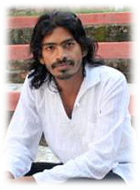
Sristi Village
Inclusive, self-sustaining and Eco-friendly Village for the marginalized people with intellectual disabilities.
Karthik Current Investee: Level 2, 2014; Level 1, 2013
Area: Villupuram
www.sristivillage.org/
The issue: A lot of children with intellectual disabilities are abandoned due to lack of governmental support and lack of awareness. The intellectually disabled need to experience acceptance.
The idea: Karthik’s idea is to create an inclusive, self sustaining and eco friendly village for marginalized people with intellectual disabilities - a community that is secure.
How it started: Growing up in an orphanage Karthik saw a need to provide opportunities to empower those intellectually disabled who might be willing and able to contribute to the community. Many of those who he grew up with were unable to get a job because employers looked at their disability and not the possibility.
The team: Sristi Village currently has 15 member in their community and 6 members in the team (including Karthik) .One each of the psychologist, health inspector, lab technician and 2 social workers.
Sristi and UnLtd Tamil Nadu: Karthik asked UnLtd Tamil Nadu to support him with milestones, financial planning, fundraising strategy, website updating, coaching and mentoring.
UnLtd Tamil Nadu

Slide 14
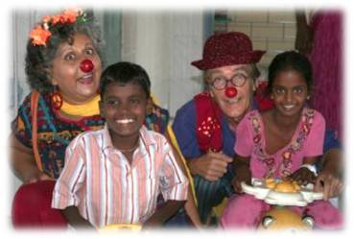
Komali Medi Clown
The issue: The joy , hope and healing through therapeutic clowning, laughter and humor to all in rural and urban India is less known.
The idea: Fif and Hamish’s idea is to bring about an innovative wellness program integrating the joy of therapeutic clowning, laughter, and humor, with scientific research and indigenous clowning, as a holistic approach for the preventive and curative well being of individuals and communities in rural and urban India. This is done by training people to work as Medical Clowns so that they might become laughter leaders in hospitals providing healthcare, schools and educational institutions in rural and urban areas of India.
How it started: When Fif was 18 years old she witnessed a 16 year old girl who had attempted suicide being rushed to a hospital in Trivandrum. By the next morning she had passed away and this had a devastating effect on her. The next 18 months she continued volunteering in Southern India in cities doing clowning, puppetry, theatre and social work when she learned about her Indian roots.
The team: Fif has an educational background in theatre and has been involved in theatre education and healthcare in Canada, United States, India and Uganda for over 30 years. Komali Medi Clown and UnLtd Tamil Nadu: Fif and Hamish asked UnLtd Tamil Nadu to support them with networking with experts and peers, coaching and mentoring, finances, crowd funding, business development and Seed funding of Rs. 80,000
Healing by therapeutic clowning
Fif and Hamish
Current Investee: Level 2, 2014; Level 1, 2013.
Area: Auroville
UnLtd Tamil Nadu

Slide 15
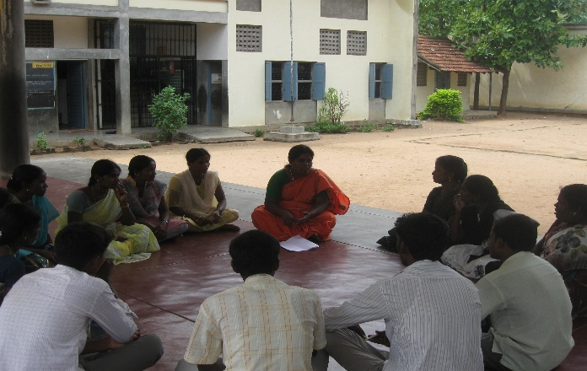
Children’s Parliament
Increase children’s participation in social change
Logammal
Current Investee: Level 1 , 2014;
Area: Thiruvallur
The issue: Children coming from families grappling with poverty, end up as drop outs from school and grow up to be mediocre and incompetent adults offering less hope for themselves and their communities. Children’s participation in social change helps them take responsibility and create better world.
The idea: Children’s parliament promotes child participation and makes them as vehicles and ambassadors of social change by providing solutions to social problems in the community. This helps build the overall personality and competence of the child. It also helps create a society where children who grow up into adults are conscious not just of their rights but also their duties. How it started: Logammal was inspired by a 12-year old boy she heard speaking at one of the children’s parliament. Hence she began her own children’s parliament. The team: Logammal has a bachelors in Sociology and has 14 years of work experience with Ecom Well and Pasumani Trust in the area of community development and health. Children’s Parliament and UnLtd Tamil Nadu: Children’s Parliament asked UnLtd Tamil Nadu to support them with coaching, fund-raising and networking support
UnLtd Tamil Nadu

Slide 16
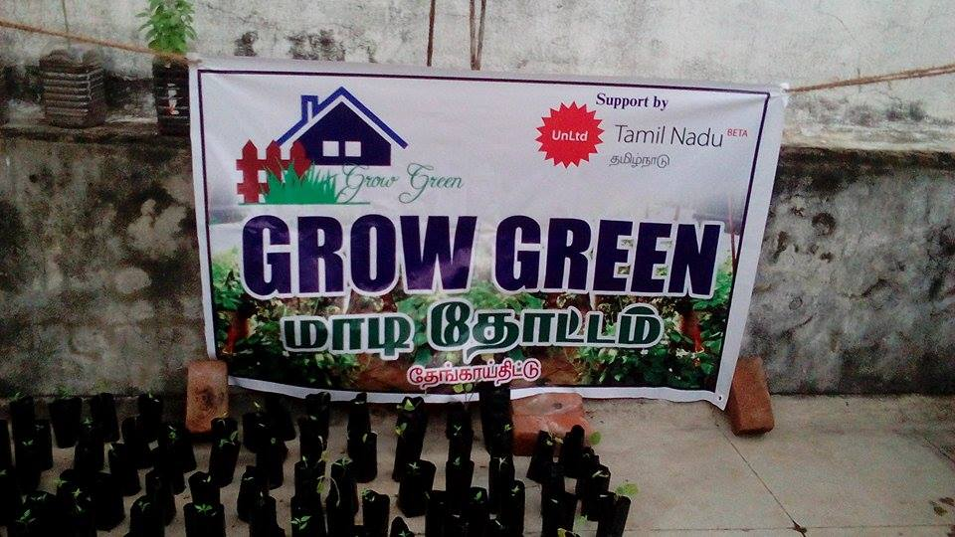
Grow Green
The issue: In the recent past, use of fertilizers is on the rise and house gardening is decreasing to a new low.
The idea: Palanivel’s idea is to promote organic home gardening, specifically terrace gardens. Most homes today have very little space on the ground, however, most have an open terrace, which currently is not being well-utilized; Palanivel wants people to effectively utilize this space by having their own organic kitchen garden where one could grow vegetables and herbal plants. He also wants to explore working with waste materials that could be deployed for creating these gardens. His focus is on a greener earth, cleaner air, less consumption of produce grown on chemical fertilizers, more effective utilization of spare time and better utilization of waste materials. How it started: Concerned about the harmful effects of food produced from chemical fertilizers, Palanivel started Grow Green. Grow Green and UnLtd Tamil Nadu: Grow green asked UnLtd Tamil Nadu to support them with creating a sustainable model, networking, coaching & mentoring.
Organic house gardens
Palanivelu
Current Investee: Level 1 , 2014;
Area: Pondicherry
UnLtd Tamil Nadu

